Slide 1
Android Testing and Previous Labs
TAN, Shin Hwei 陈馨慧
Southern University of Science and Technology

Slide 2
Arrangement for Week 8
No lecture will be held on Week 8 due to the 清明holiday.
There will also be no lab for the labs on Monday, and Tuesday (4 April and 5 April)
Other lab session (6 April) will use this slides for revision and reminder for previous lab assignments, and project.

Slide 3
Part 1: For those of you who are selecting Android apps for the project: Android Testing
Slides from https://www.vogella.com/tutorials/AndroidTesting/article.html

Slide 4
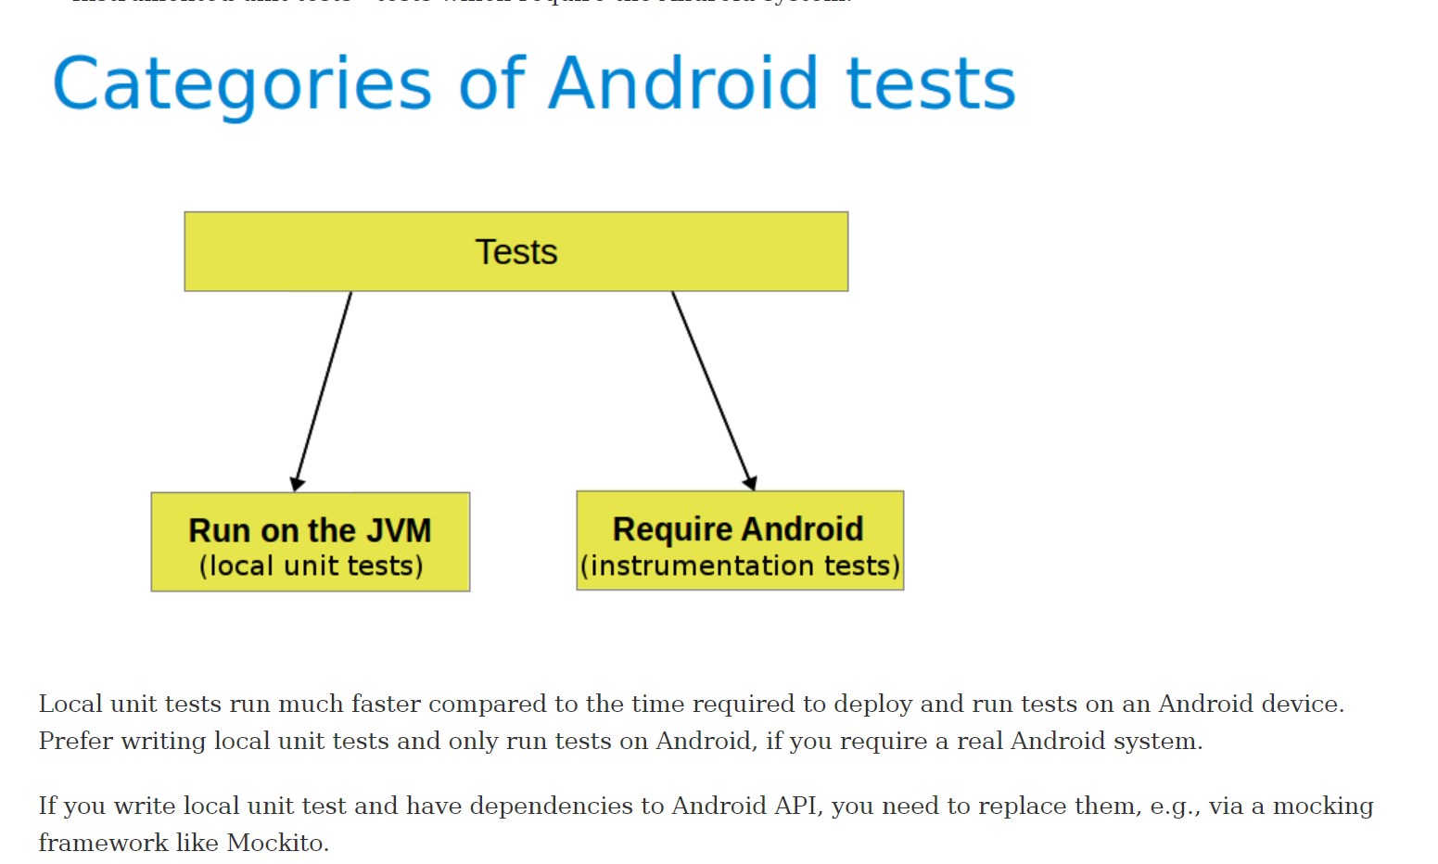

Slide 5
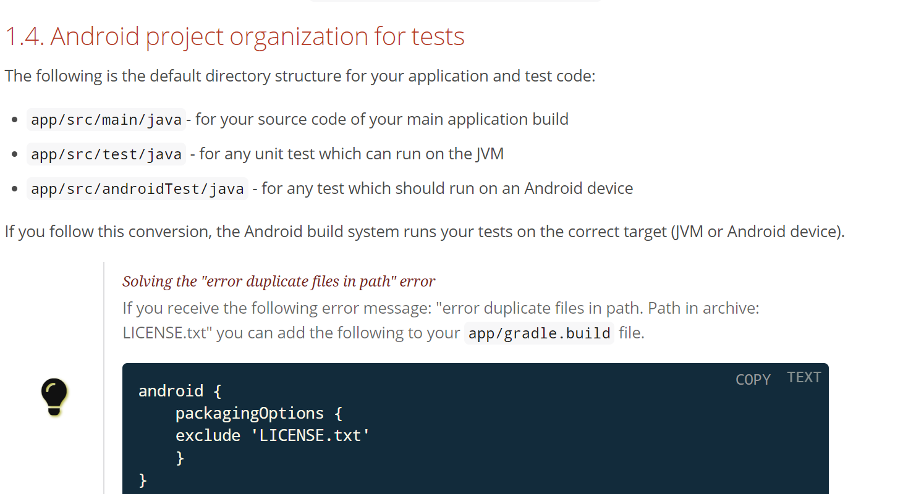

Slide 6
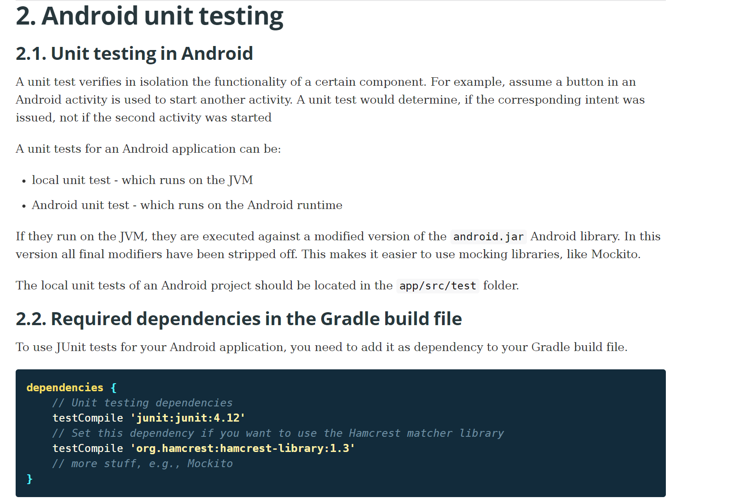

Slide 7
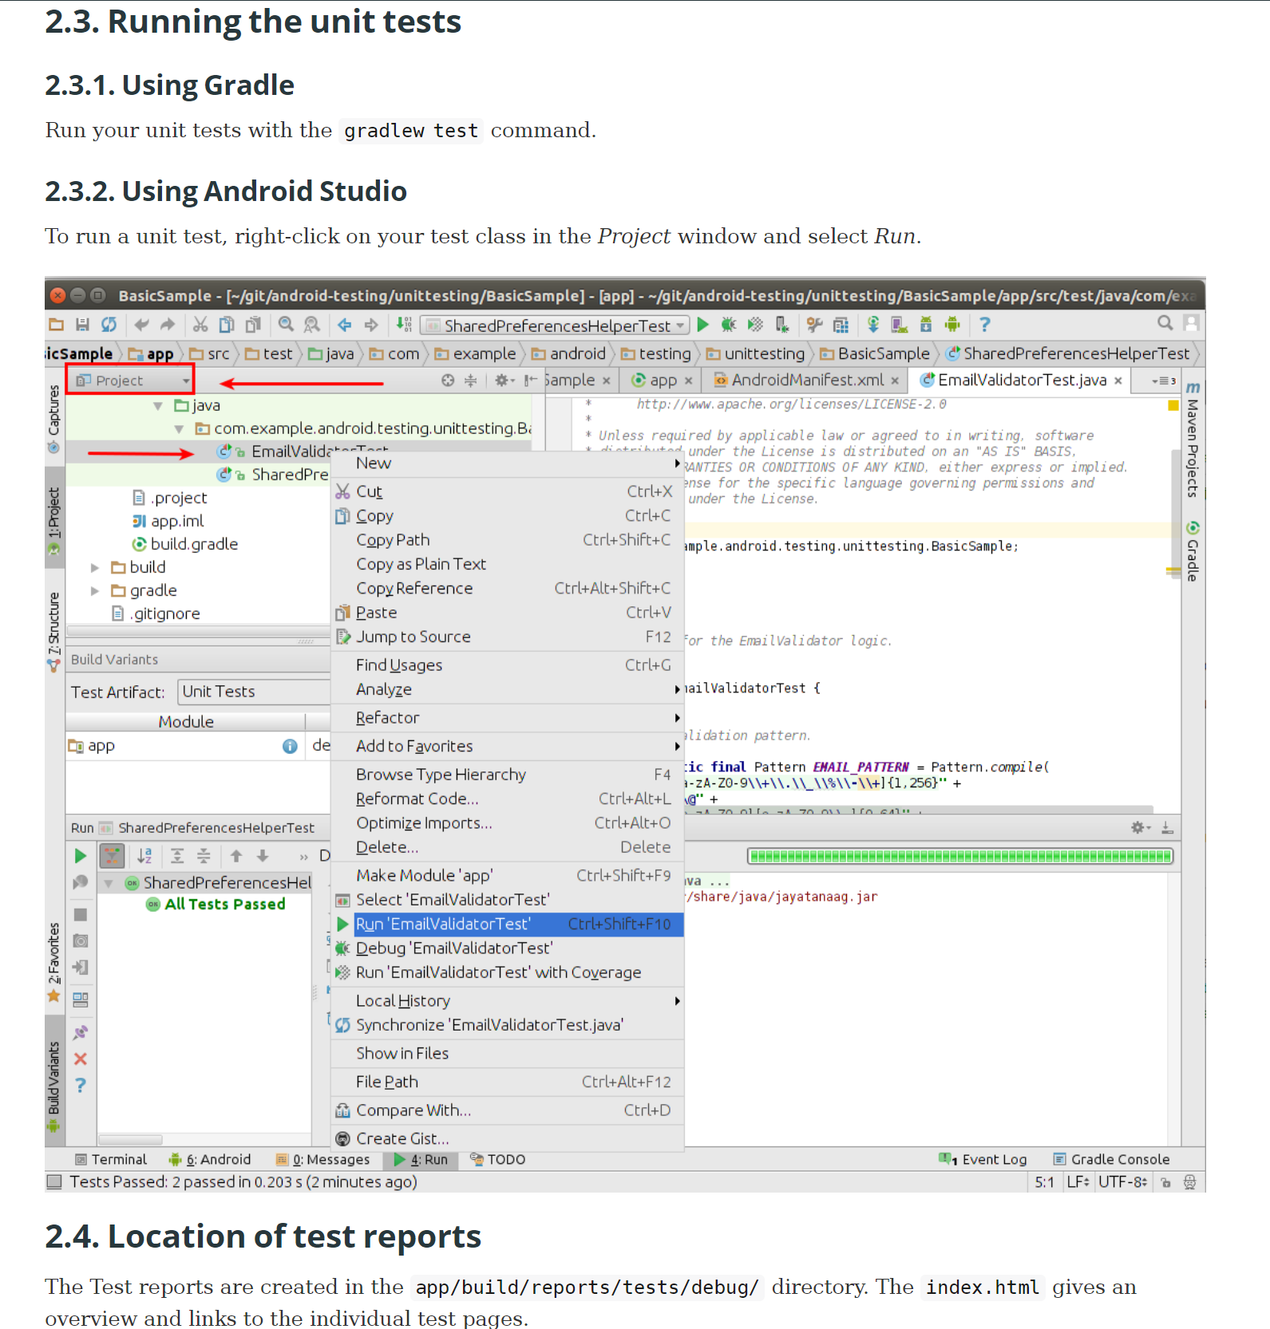

Slide 8
Android UI Testing
Slides from https://www.vogella.com/tutorials/AndroidTestingEspresso/article.html

Slide 9
The Espresso test framework
A testing framework for Android to make it easy to write reliable user interface tests.
automatically synchronizes your test actions with the UI of your app.
ensures that your activity is started before the tests run & let the test wait until all observed background activities have finished.
Used for testing a single app but can also be used to test across apps. If used for testing outside your app, you can only perform black box testing, as you cannot access the classes outside of your app.

Slide 10
Record an Espresso test
Espresso tests consist of 2 components:
UI interactions
tap and type actions used to interact with your app
Assertions on View elements
Verify the existence or contents of visual elements on the screen.
Example: an Espresso test for the Notes testing app might include UI interactions for clicking on a button and writing a new note but would use assertions to verify the existence of the button and the contents of the note.

Slide 11

Record UI test with Espresso Test Recorder
From: https://developer.android.com/studio/test/espresso-test-recorder

Slide 12
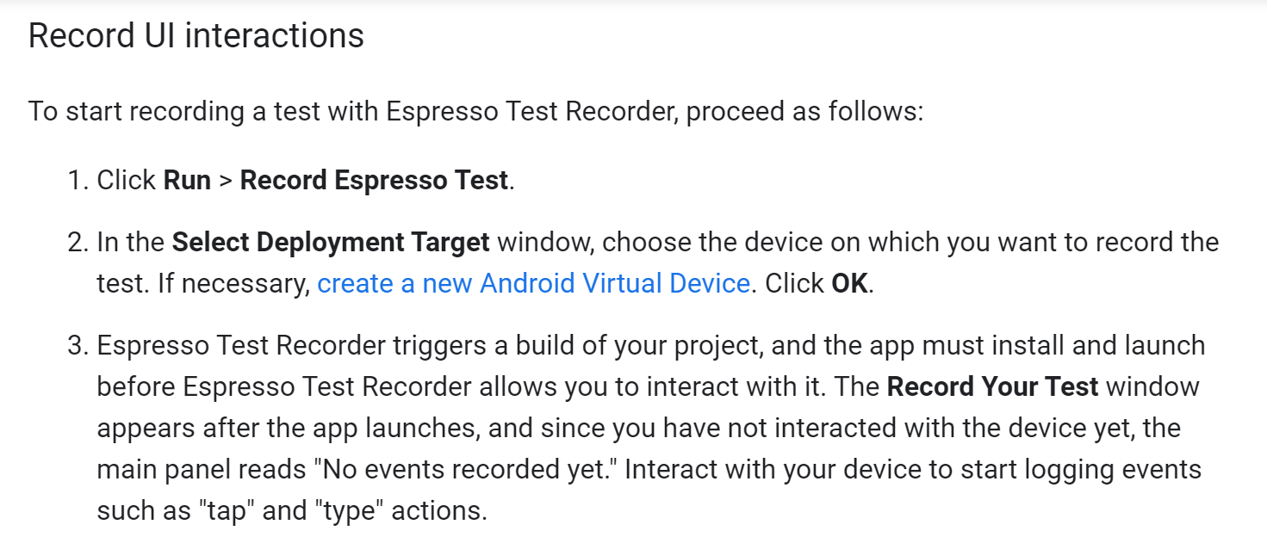
Record an Espresso test

Slide 13
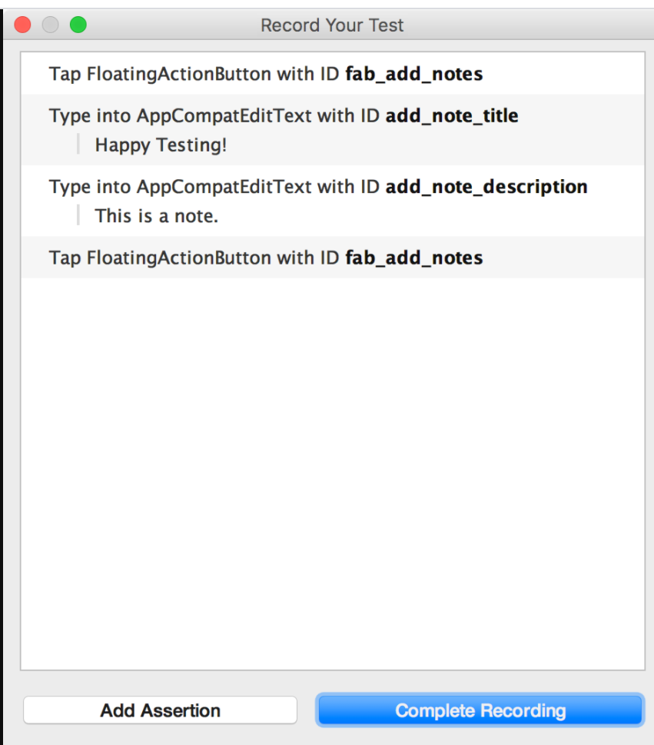
Assertions
Assertions verify the existence or contents of a View element through three main types:
text is: Checks the text content of the selected View element
exists: Checks that the View element is present in the current View hierarchy visible on the screen
does not exist: Checks that the View element is not present in the current View hierarchy

Slide 14
Add Assertions
To add an assertion to your test, proceed as follows:
Click Add Assertion. A Screen Capture dialog appears while Espresso gets the UI hierarchy and other information about the current app state. The dialog closes automatically once Espresso has captured the screenshot.
A layout of the current screen appears in a panel on the right of the Record Your Test window. To select a View element on which to create an assertion, click on the element in the screenshot or use the first drop-down menu in the Edit assertion box at the bottom of the window. The selected View object is highlighted in a red box.
Select the assertion you want to use from the second drop-down menu in the Edit assertion box. Espresso populates the menu with valid assertions for the selected View element.
If you choose the "text is" assertion, Espresso automatically inserts the text currently inside the selected View element. You can edit the text to match your desired assertion using the text field in the Edit assertion box.
Click Save and Add Another to create another assertion or click Save Assertion to close the assertion panels.

Slide 15
Part 2: Reminder of previous assignments

Slide 16
Previous Lab Assignments
Below are lab assignments that have been posted in the past few weeks:
Coverage Lab:
https://classroom.github.com/a/rtj7QxND
Junit Lab (Pair Testing) If you couldn’t find a partner, you can complete this alone:
https://classroom.github.com/a/0EgnbwO5
Metrics lab:
https://classroom.github.com/a/uD2YOLI2
PIT mutation lab:
https://classroom.github.com/a/q9vuleVv
The lab assignments should be completed after each lab. The deadline for all lab assignments is the last week of class.

Slide 17
Assignments/Project
Below are assignments/project:
Progress report due on April 23
https://classroom.github.com/a/mpLhrIco
The lab assignments should be completed after each lab. The deadline for all lab assignments is the last week of class.

Slide 18
Junit Lab: Simple TriType Example
TriTyp: Given three integers for the lengths of the sides of a triangle, find the type of triangle
Try testing the “Triang(int, int,int)” method
Go to this link to get the program:
https://classroom.github.com/a/0EgnbwO5
This is an graded (passed/failed) lab assignment. You get full score as long as you accept the invitation link and commit your test (“TriTypTest.java” file) at the last step.

Slide 19
Junit Lab: Pair Testing
Form a team of two with your neighbors
Write two JUnit tests for TriTyp individually
Write two JUnit tests for TriTyp to check for exceptions individually
Compile & run your tests & theory to see if they are passing
Show all your tests to your teammate and try the following:
Convince your teammate that your tests are better
Convince your teammate that your tests are testing different behavior than his/her tests
Convince your teammate that your tests are of the same quality
Let your teammate knows if you feel that his/her test is better
Combine all the final tests and save as “TriTypTest.java” file. Commit the file to GitHub.
What to submit?
TriTypTest.java

Slide 20
Junit Lab: How many tests you have now?
2 JUnit Tests?
3 JUnit Tests?
4 JUnit Tests?
> 4 JUnit Tests?

Slide 21
Coverage Lab: Generate Test
Generate test using Evosuite for the MessageBuilder class
Use the command:
mvn -DmemoryInMB=2000 -Dcores=2 evosuite:generate evosuite:export test
Or use the “Generate Test” interface

Slide 22
Coverage Lab: Analyze each generated test
For each test, answer the following questions:
Which line will this test cover?
Rename each test to the line where each test cover
For example, if the test cover line 1, 2 and 3. Then change its name to “testL1a2a3”
Could Evosuite achieve 100% line coverage?
For each uncovered block of code, explain why the tool cannot cover.
Write more tests to increase the code coverage.
Put the answers in README.md. Put the JUnit test in TestMessageBuilder.java and commit all the files.

Slide 23
Metrics Lab Exercise Part 1
What is the Cyclomatic complexity for the class according to the plugin for the class below? Explain how to calculate the cyclomatic complexity (e.g., how many branches it have)
SwitchExample.java
Example1.java
Example2.java
Add a README.md with the following information:
Name:
Student id:
Screenshot showing the results of the plugin

Slide 24
Metrics Lab Exercise Part 2
Answer the following questions by modifying the README.md that you have created in Lab Exercise part 1
Part 2: Metrics for my project
What is the Lines of Codes of your selected project? (If you selected two projects, you just need to select one of the projects to answer this question)
What is the maximum Cyclomatic Complexity of the classes of your project?
Do your project has any method with cyclomatic complexity >10? If yes, explain why the cyclomatic complexity is high for your project.
*You don’t need to include any screenshot for this part
*You don’t need to upload your project to the invitation link. Only need to answer questions in README.md

Slide 25
PIT Lab Exercise
Write JUnit test to achieve 100% mutation coverage for both:
MyClass.java
StockService.java
Add a README.md with the following information:
Name:
Student id:
JUnit tests for MyClass.java
JUnit tests for StockService.java
Screenshot of PIT results showing that you achieved 100% mutation coverages for both class

Slide 26
Project

Slide 27
Follow the plan for your project
Start writing tests to reproduce the bugs in the selected issues
Implement the selected issues according to plan
Don’t forget to write documents (Javadoc comments) and tests!
Ask question in https://github.com/orgs/cs304-2022/teams/all-students/discussions/1

